Slide 1
Rotary Information Event
Using the YASS Method to organise
a Rotary Information Event

Slide 2
Background
Created by Rotary Club of Yass (NSW)
Designed to reach out and connect with potential Rotarians
Step by step system
Used successfully by several Rotary clubs
Important to follow the process
Notes:
Clubs in D9910 who have used the YASS system
Birkenhead
Milford
Henderson

Slide 3

Step 1 – Set the date
Now you have a deadline!
Notes:
SET A DATE FOR THE MEMBERSHIP NIGHT
It’s important you do this first because you have a deadline to get things done and a goal to reach.

Slide 4

Step 2 – Talk to Members
Potential invitees
Fit to Rotary
Correct name
Home postal address
Notes:
TALK TO MEMBERS AND GET THEM THINKING OF PEOPLE TO INVITE.
The members don’t need to know the people well but just know them well enough to be sure they would suit ROTARY
They also need to know their correct name and home address; home addresses are more personal
Suggestions: Neighbours, tradespersons, local professionals, co-workers etc.

Slide 5
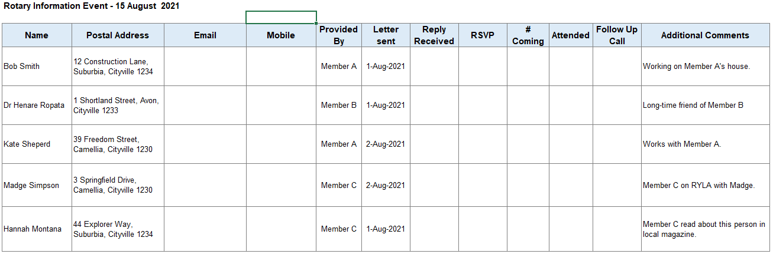
Step 3 – Create a database
Names
Addresses
Date invite sent
Contact details
RSVP
Comments
Notes:
CREATE A DATABASE
Include invitee names, addresses, contact details;
Make sure you update when the letter is sent, reply received and any comments, especially people who make contact but can’t come;
Maintain progress status of invitee

Slide 6

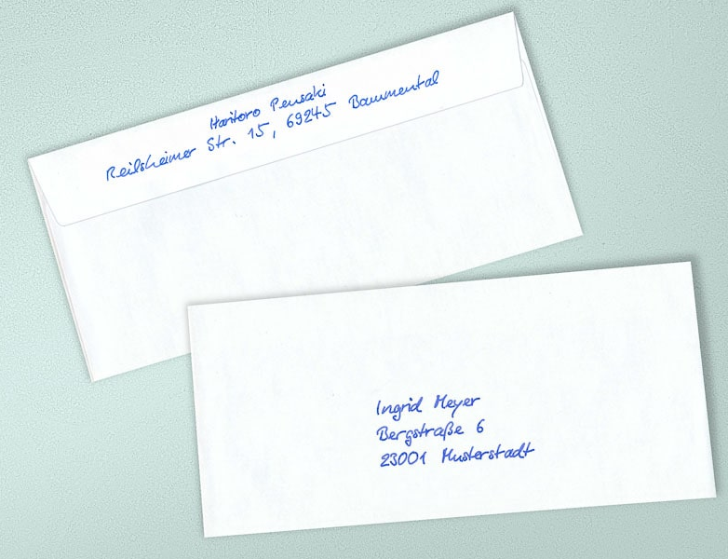
Step 4 – Write a letter
Sent 2-3 weeks before event
Club letterhead
Concise
Signed by President
Hand-written envelope
Rotary Birkenhead
c/- 17 Birkenhead Avenue, Birkenhead 0746
Sunny and Leo Sayer
Address Line1
Address Line2
City, Postcode
Notes:
WRITE A PERSONALLY ADDRESSED LETTER TO EACH PERSON
The letter must be on Club letterhead
The President personally signs the letter.
Posted in a hand-written envelope.
Send out two weeks before the event.
Suggest indicating it is only a one hour event
Don’t make the letter too long.
Template available on district website (rotarydistrict9910.org) under For Rotarians / Club Development

Slide 7
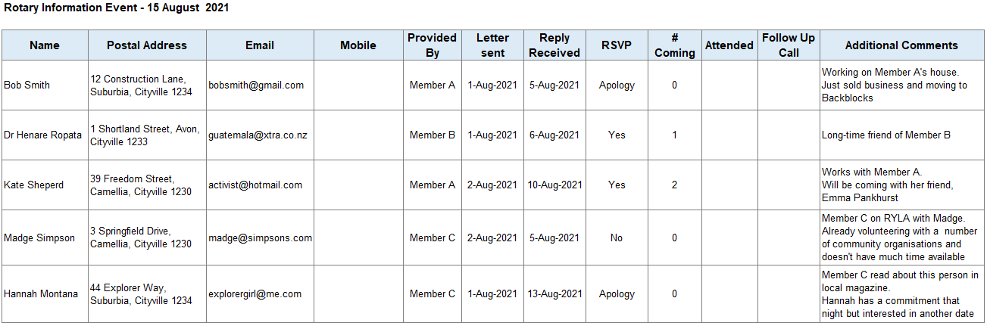
Step 5 – Update database
Update RSVPs
Update Comments
Follow up on returned invites
Notes:
UPDATE DATABASE
Make sure person/s who say no are retained on the database - the fact they have replied shows they are interested but not at this stage.
If you get ‘returned’ invites – follow up with the member who provided the name and address to confirm correct postal address and re-send

Slide 8
Step 6 – The Event (preparation)
THIS IS NOT A MEETING
One hour duration
Drinks and finger food
Rotary signage
Prepare club information
All members have a role
Notes:
EVENT PREPARATION
THIS IS NOT A MEETING
DO NOT HAVE A GUEST SPEAKER – this is an information event about Rotary, not some cause.
Event duration is one hour
Keep the event casual with finger food – NOT A SIT-DOWN MEAL
Have a very good MC who welcomes everyone, is not overbearing and keeps the event flowing.
Create a running sheet to keep the event to time.
Arrange Rotary signage and book district materials if required
Have a screen with the Rotary logo and club name up on it.
Have guest name tags printed out and ready with reception so guests know they are expected.
Prepare the club information handout and the club members sharing stories
All members should wear their club name badge and Rotary-branded clothing so they are distinguishable in the crowd
Use members to
Act as ‘greeters’ bringing guests to reception to get their name tag and details
Be on reception to give guests’ their name tag and update the database, particularly with any details not recorded
Serve the food platters, which encourages chatter
Manage the bar
Mix and mingle showing how Rotary is fun while doing good for the community.

Slide 9
Step 7 – The Event (in action)
20 mins mix and mingle;
20 mins of Rotary stories;
20 mins chatting afterwards.
Use the stories to illustrate Rotary
1 to 2 minute Rotary video from My Rotary
Have FUN
Notes:
THE EVENT IN ACTION
THIS IS NOT A MEETING
DO NOT HAVE A GUEST SPEAKER – this is an information event about Rotary, not some cause.
20 minutes mix and mingles, 20 minutes of Rotary Stories and 20 minutes chatting after.
Keep the event casual
Have four or five members tell their Rotary Story
Maximum of 3-5 minutes
Have a mix of ages and genders if possible
Use the stories to illustrate Rotary without making it sound like hard work.
Make sure you have chosen members who tell a story well and have a good story to tell
This is not a run down on projects the club does or the money it makes but lots of stories to which guests may relate;
For example:
Funny happenings when undertaking your first project;
Experiences visiting other clubs when travelling for work/holiday;
The joy of having an exchange student staying with you;
The club looking after a ROMAC family;
What the Rotarians get out of Rotary etc
MUST NOT BE LONGER THAN 5 Mins.
End with a 1 to 2-minute Rotary video from My Rotary

Slide 10
MOST IMPORTANT
DO NOT ASK
ANYONE TO
JOIN
ROTARY
Notes:
DO NOT ASK IF THEY WOULD LIKE TO JOIN ROTARY AT THE EVENT
This is an informal, information event where each party is getting to know each other, de-mystify Rotary, discover expectations and what Rotary offers.
We don’t want to look desperate!

Slide 11
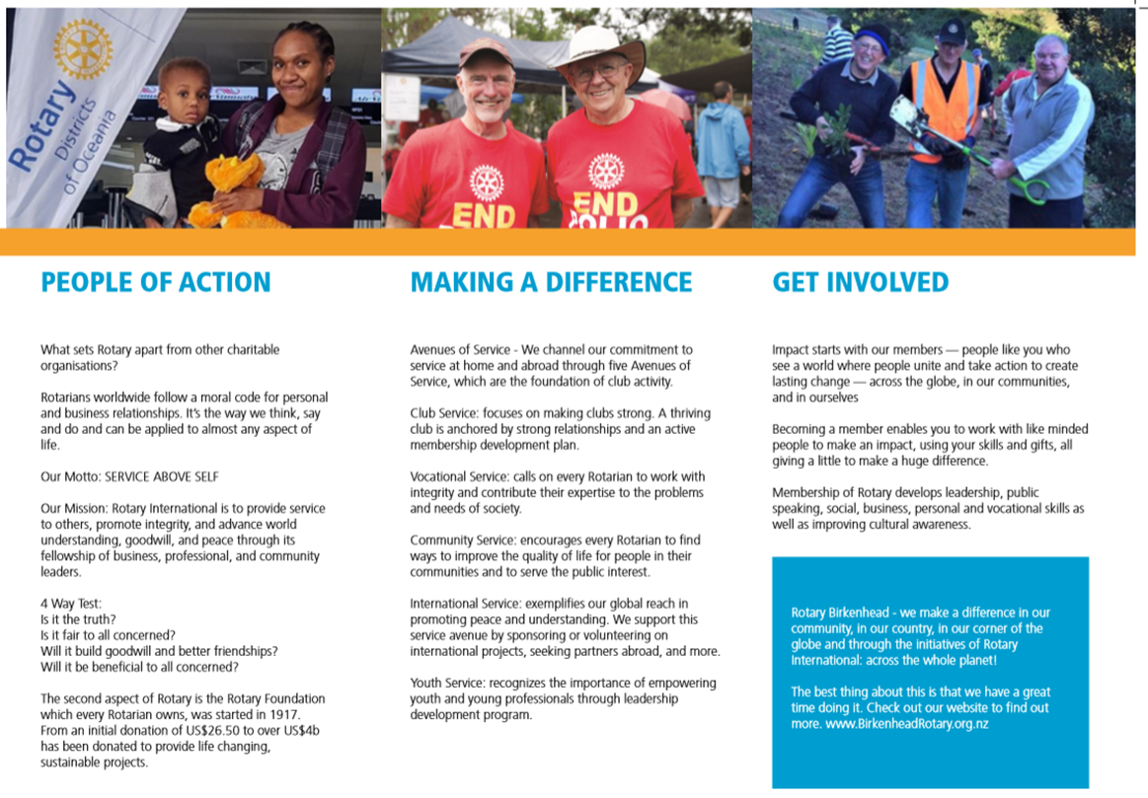
Step 8 – The Event (take away)
Handout
Use template in Brand Centre
Club photos
Club information
Notes:
EVENT TAKEAWAY
At the end of the event, thank the guests for coming;
Give guests information about Rotary and your club to take away
Use the template in the Brand Centre to create a club brochure using club photos, wording from Rotary Website and get it printed professionally

Slide 12

Step 9 – Follow Up
Ring the next day
Did they enjoy the event?
Would they like to attend a meeting or project?
DON’T ASK IF THEY WOULD LIKE TO JOIN ROTARY!
Notes:
FOLLOW UP
Each Guest should be followed up the next day, by phone, and asked if they enjoyed the event
Ask them if they would like to attend a club event next week (meeting, social event, project)
DONT ASK IF THEY WOULD LIKE TO JOIN ROTARY JUST YET – you don’t want to look desperate!

Slide 13

Step 10 – Next Connections
1st meeting – see how a normal meeting runs
2nd meeting –Club Membership Lead connects & arranges a catch up outside of Rotary.
3rd meeting – enjoy meeting, possible induction
Notes:
NEXT CONNECTIONS
The potential members should be asked to at least three meetings as a guest.
The first to see how a normal meeting runs.
The second is for the club Membership Lead to connect and arrange a catch up outside of Rotary to gauge interest, discuss costs and requirements of Rotary.
Membership Application form may be completed at club meeting or in 1on1 meeting
The board considers the candidates application to Rotary and advises members.
At the third meeting just enjoy the meeting and possibly their induction.
Other connections during this period may also be at social events or projects

Slide 14
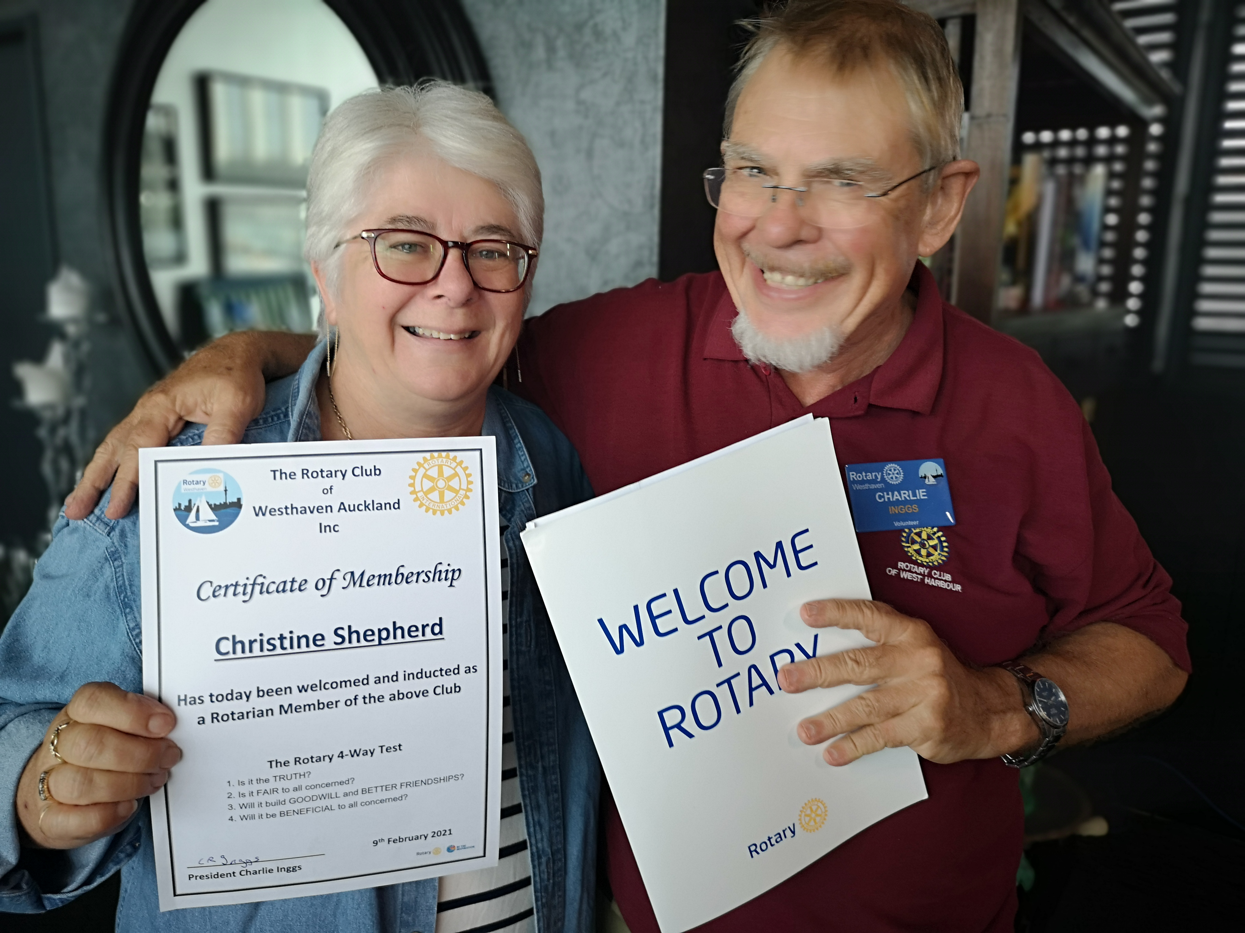
Step 11 – Induction
No later than five weeks after information event
Make it special
Have a Welcome Kit
Invite new member’s partner/family
Notes:
INDUCTION
This should be done as soon as possible either at the third meeting or no later than five weeks after the information event.
Welcome Kits are available from the district – go to rotarydistrict9910.org / For Rotarians / Club Development or rdusupplies.com.au
Make it special - invite the new member’s family and or friends

Slide 15
Points to Note
Have a small organising group and plan each step
Have a budget.
Finger food and drinks should account for all diets
Ensure all members understand their role.
Use My Rotary’s Brand Centre
Follow Up has to be done
Be open about cost and time involved
Ensure the club programme following is engaging
Notes:
POINTS TO NOTE
Have an organising committee – possibly the President, definitely Membership Lead and one or two others organising the event, keep it tight.
Plan each step of the event. It’s all in the detail
Have a budget to ensure all costs are covered.
Make sure the finger food is easy to eat and covers all diets, such as vegetarian, gluten-free, dairy-free.
Provide a wide variety of drinks - alcohol and non-alcohol.
Make sure all members have a job at the event and understand their role.
Use My Rotary’s Brand Center to ensure your Rotary branding is current, especially your letterhead
Make a brochure with Brand Center’s template using photos from your club or use photos on My Rotary and wording from www.rotary.org.
Have all the information you need for candidates ready before the event
Make sure the event runs smoothly. You are selling brand Rotary.
Follow Up – make sure this is done. Delegate if need be
Make sure the candidate knows the cost and time involved, don’t sugarcoat it
In the months following the event make sure the club programme is engaging - good speakers, projects, social events - to which you can invite the potential members.

Slide 16
Maintain database
Updated from information event and follow up calls
Notes:
MAINTAIN DATABASE
Make sure people who say no are retained on the database - the fact they have replied shows they are interested but not at this stage.
Update the information from what you have learned about the attendees on the night and in any follow up calls.
Could also add further columns for invites and attendance at follow up meetings/projects and final induction
Ensure the information is relevant for the next event

